Slide 1
SMART STUDY PLANNER
CAPSTONE PROJECT
Presented by :
Name: P. Murali College: R S R ENGINEERING COLLEGE Dept: Artificial Intelligence and Data Science

Slide 2
Outline
Problem statement
System development and approaches
Algorithm & deployments
Results
Conclusion
Reference

Slide 3
Problem statement
students often face challenges in organizing study schedules and tracking academic task. this planner helps users crest, view, and manage study goals with reminder and visual timelines. The goals is to boost productivity and time management .tasks and progress can be saved locally.

Slide 4
System approaches
A web-based study planner for task management
Built using HTML, CSS, and JavaScript
Local storage used to save tasks
Features: Add, complete, delete tasks
Timeline visualization for due dates

Slide 5
Algorithm & Deployment
User submits task (title, subject, deadline)
Task saved in local Storage
Tasks rendered in task list with complete/delete options
Tasks sorted by deadline and shown in timeline
Status updated dynamically (✅Done / ⏳ Pending)
Client-side application (no backend required)
Runs in any modern web browser
Can be deployed using GitHub Pages, Netlify
Requires only HTML, CSS, and JS files

Slide 6
Results & Screenshots
Successfully manages study tasks
Provides visual timeline for deadlines
Tasks persist using local storage
Simple, responsive, and user-friendly UI
GitHub link: https://github.com/muralipasupuleti42-cmyk/smart-study-planner

Slide 7
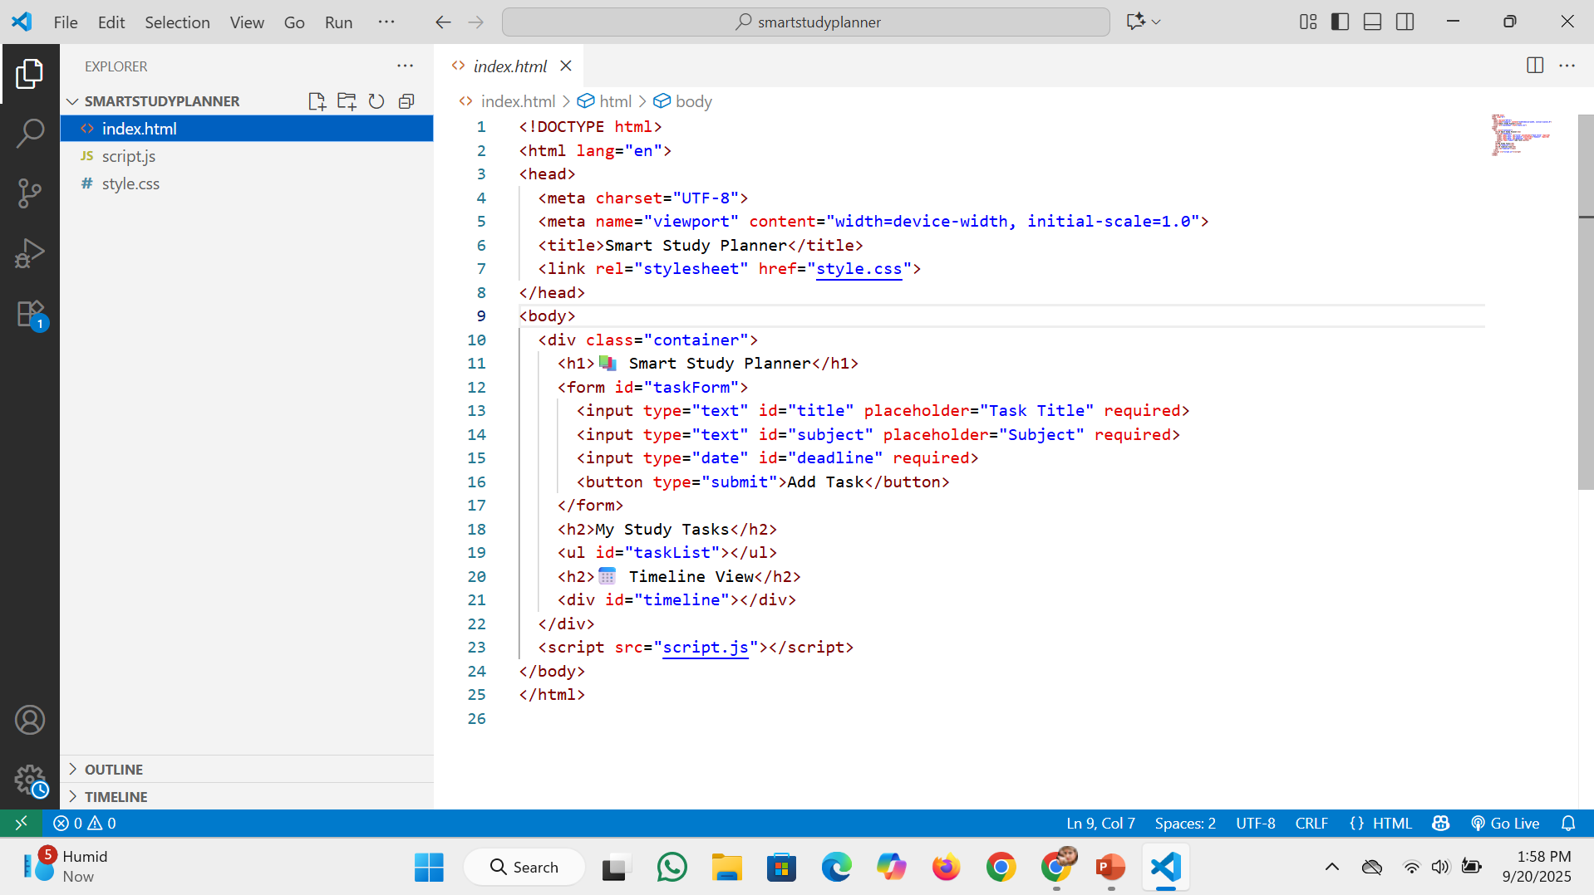
GitHub link: https://github.com/muralipasupuleti42-cmyk/smart-study-planner

Slide 8
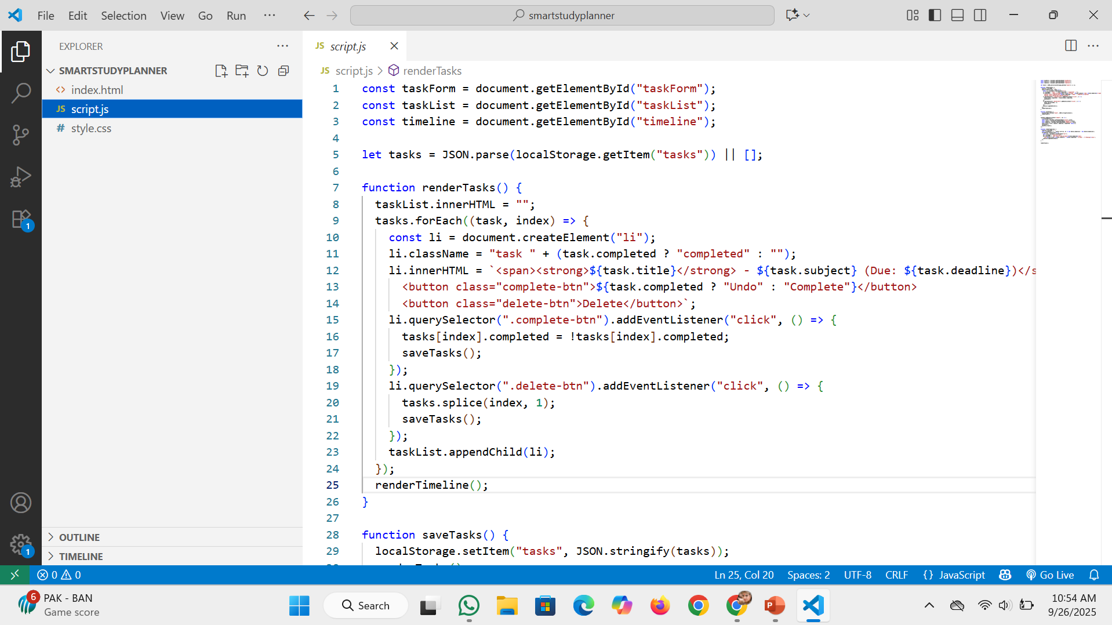

Slide 9
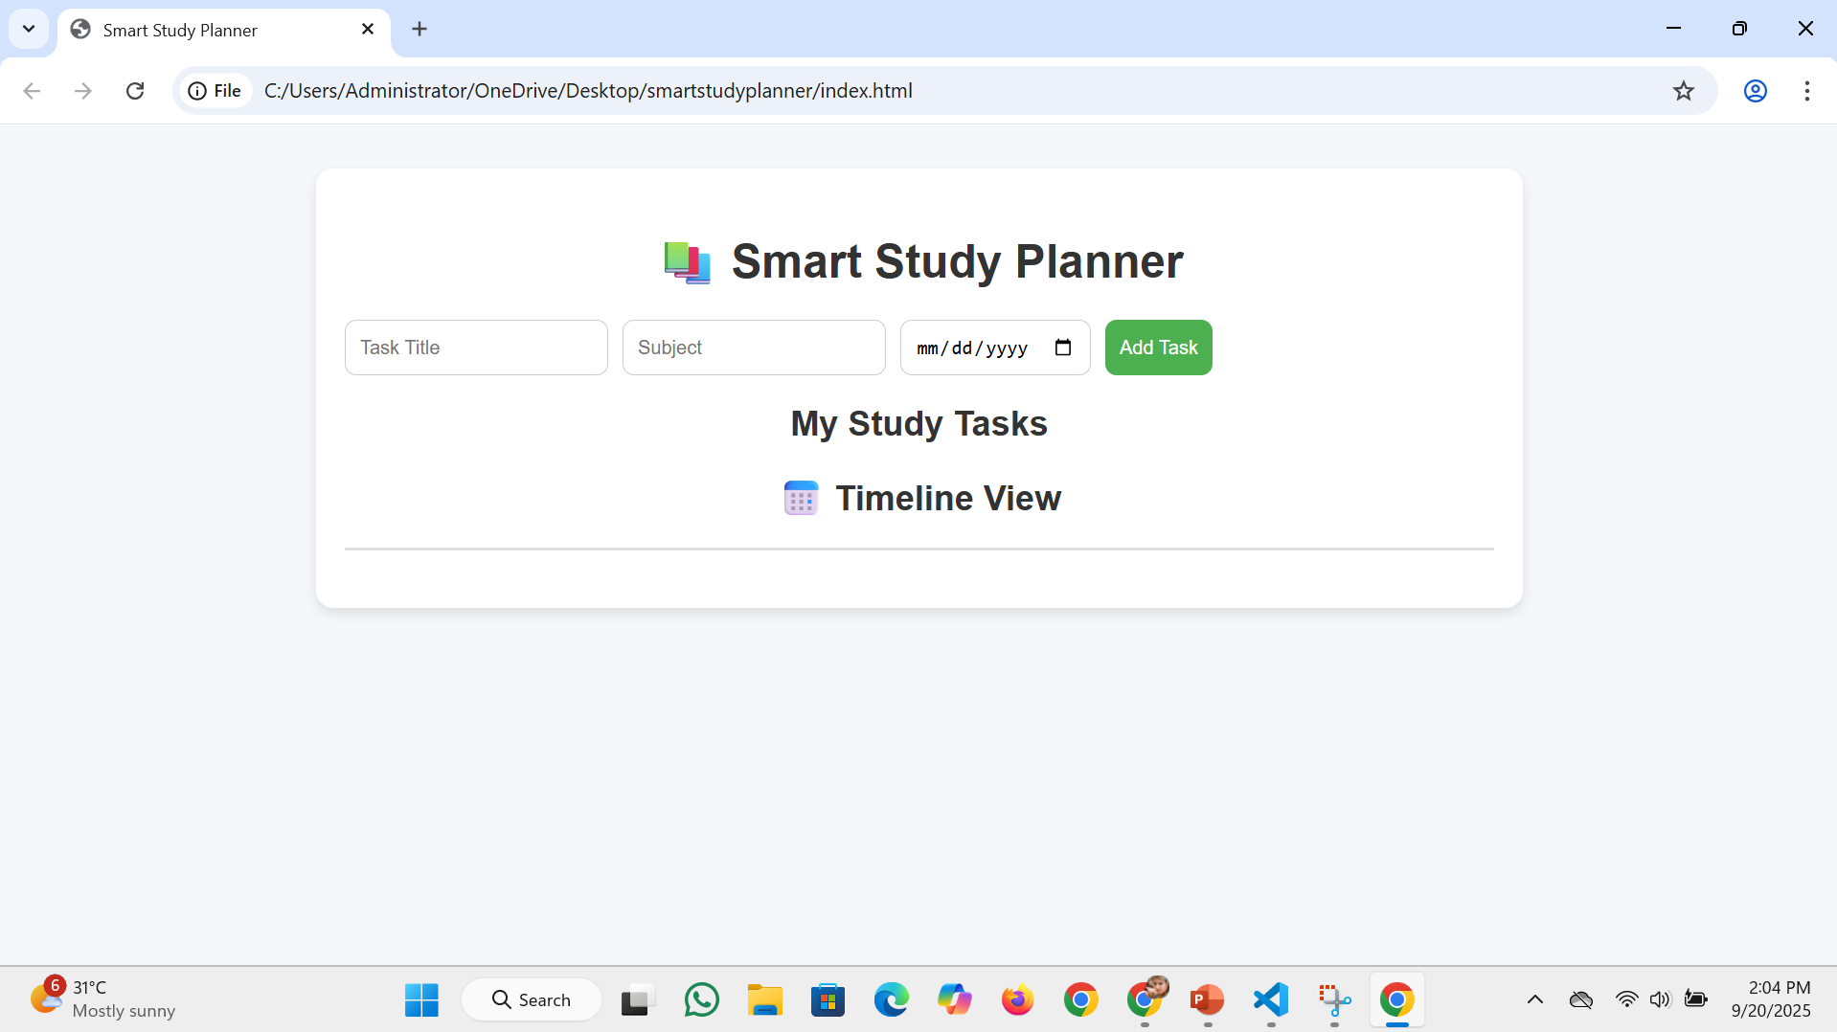

Slide 10
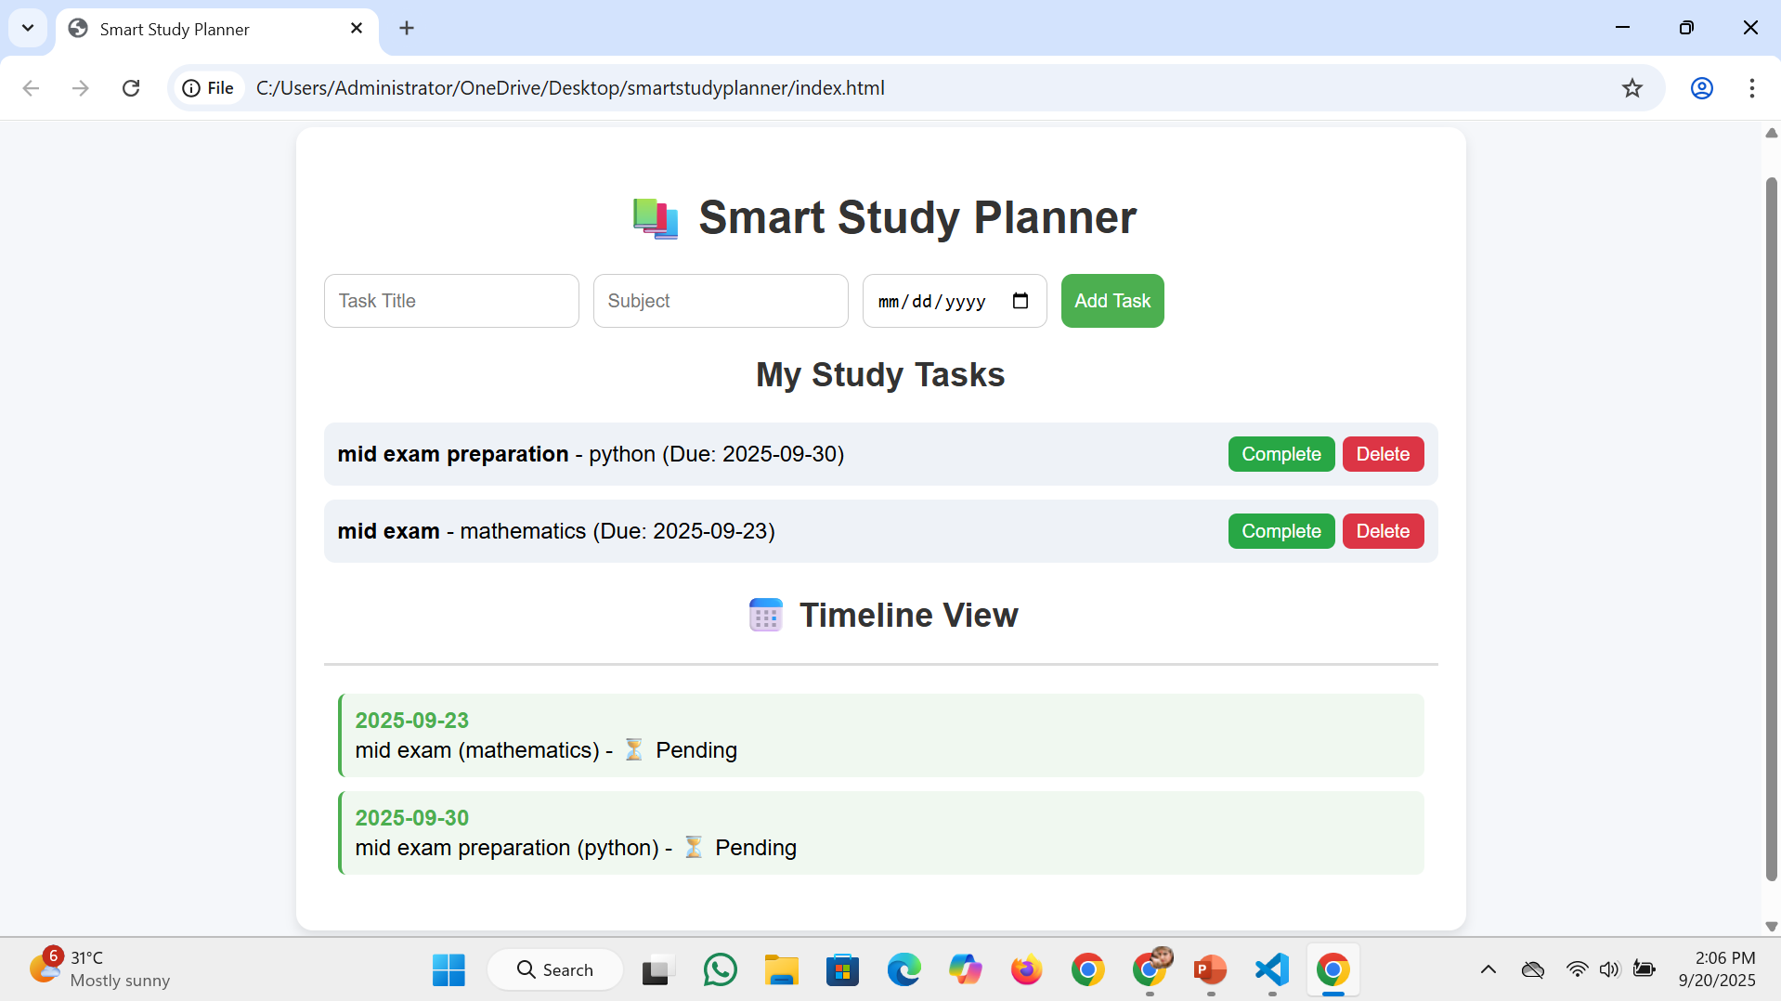

Slide 11
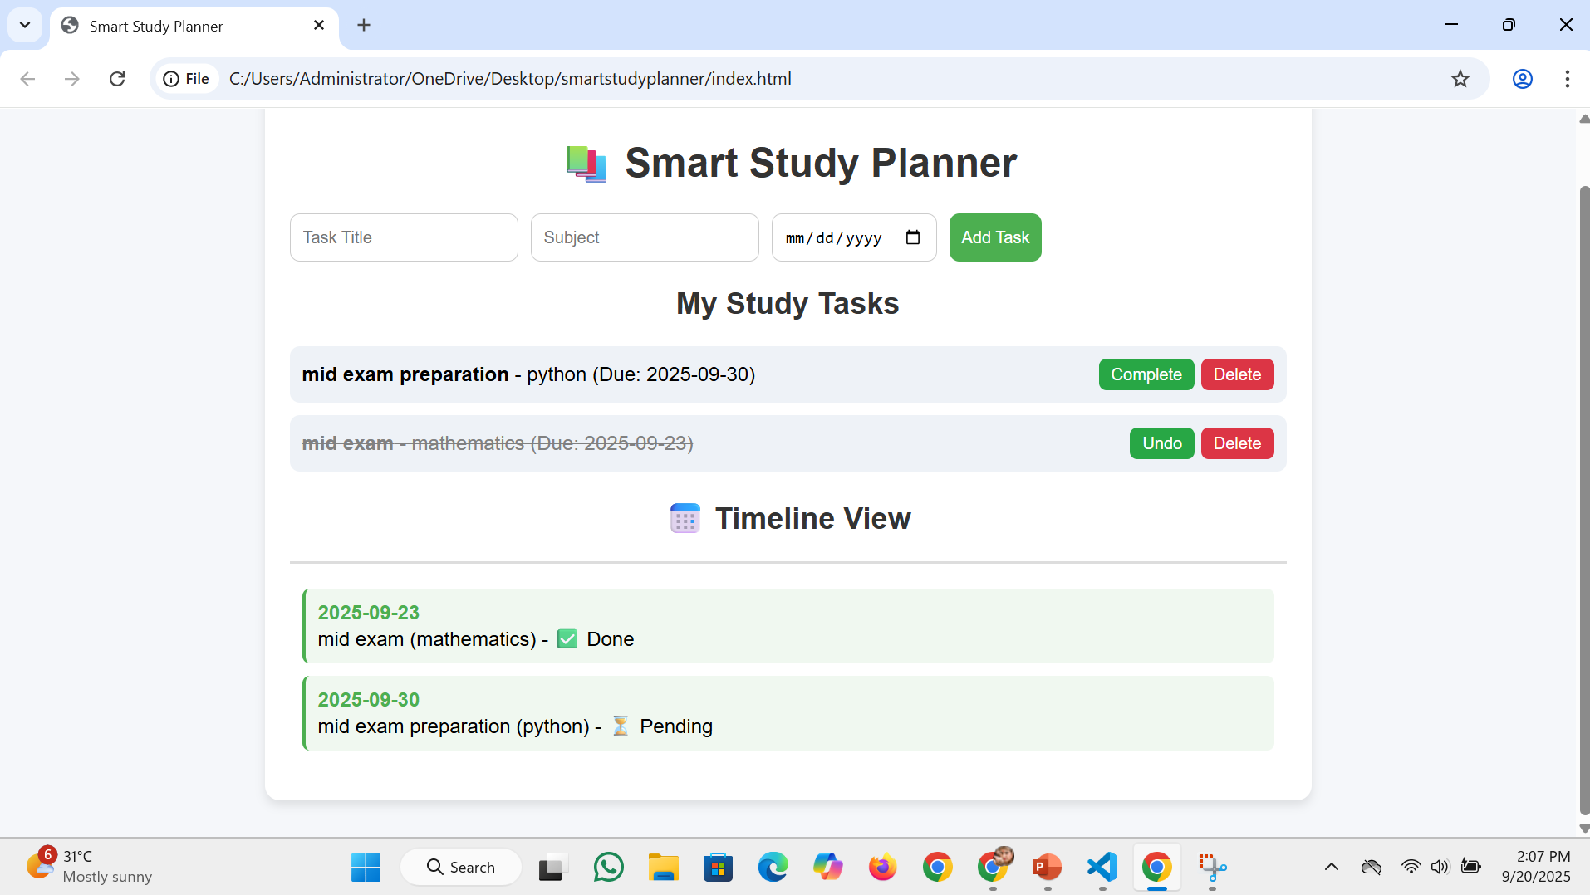

Slide 12
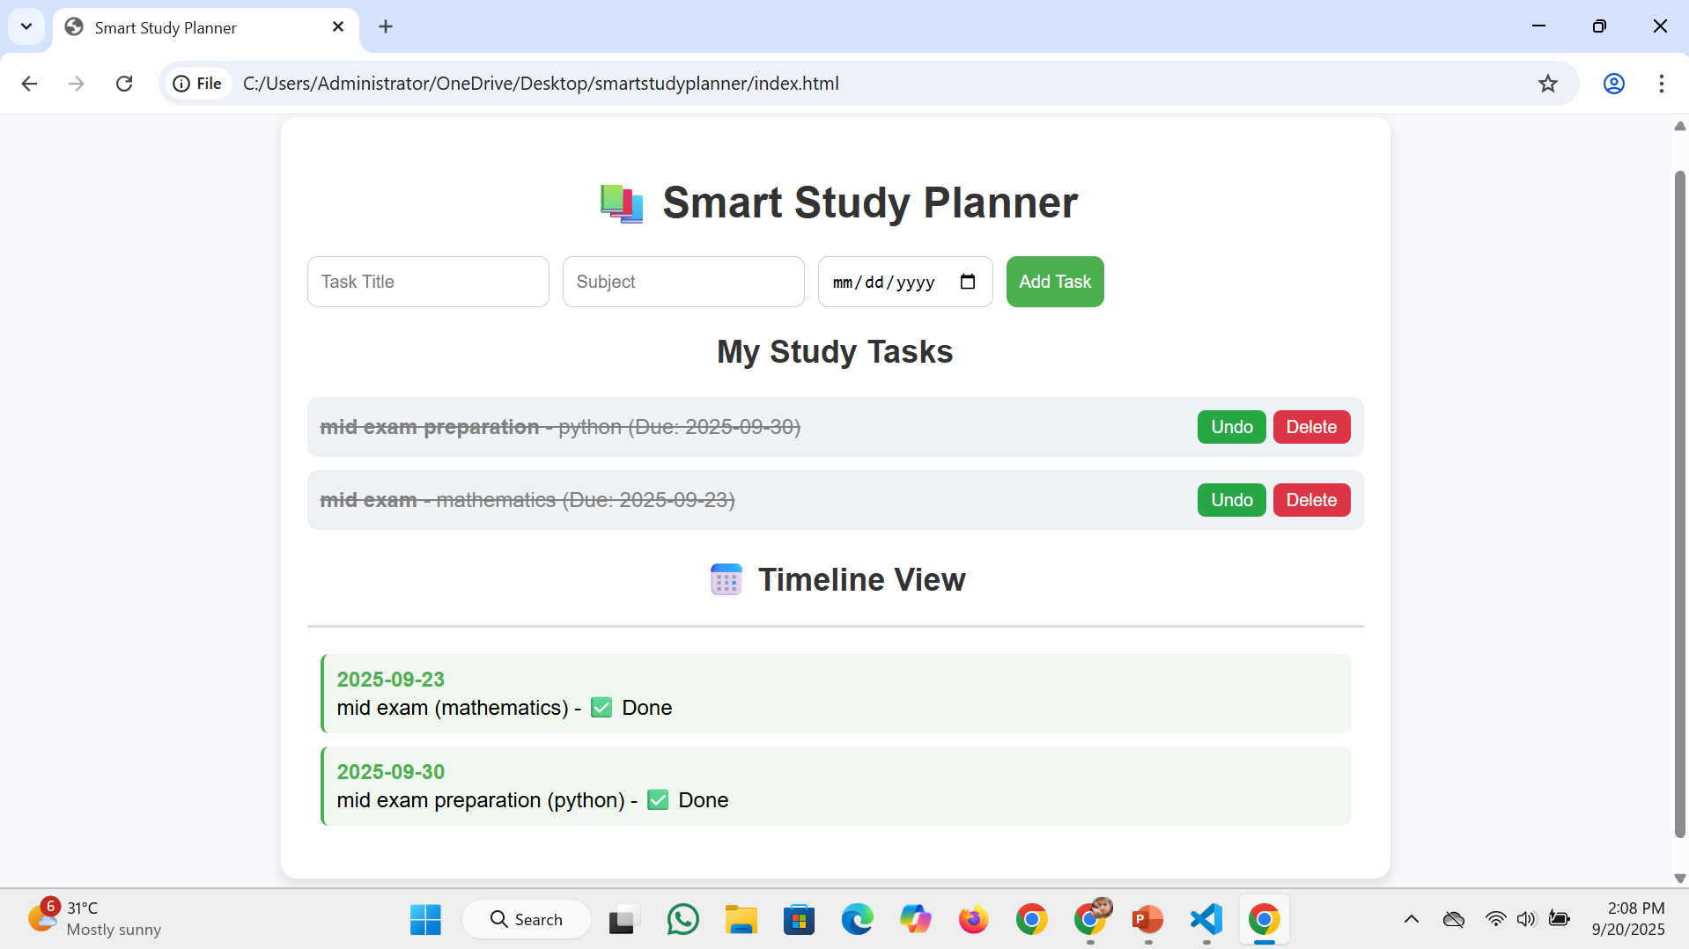

Slide 13
Conclusion
A lightweight and effective planner tool
Helps students stay organized
Can be extended with reminders and cloud sync
Demonstrates practical use of web technologies

Slide 14
Reference
List and cite relevant sources, research papers, and articles that were instrumental in developing the proposed solution
NanthiniMoha/TNSDC-FWD-DIGITAL_PORTFOLIO
Get started with Bootstrap · Bootstrap v5.3

Slide 15


